Slide 1
GCH8108 course Morteza namvar winter 2020
analytical solution of Poiseuille flow

Slide 2
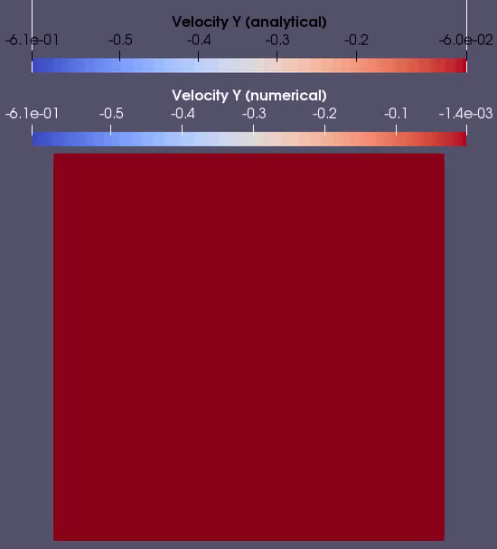
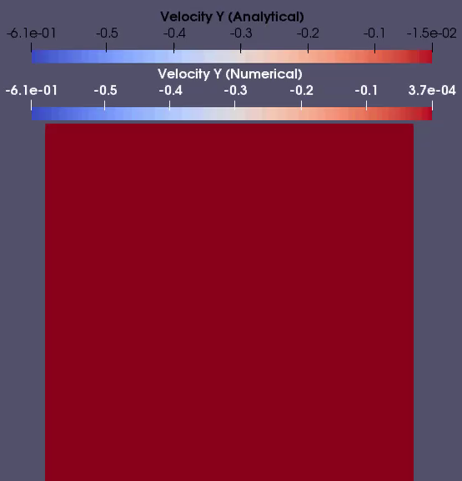
GCH8108 course Morteza namvar winter 2020
Transient evolution of the Poiseuille flow
Animation of 20*20 grid
Animation of 80*80 grid

Slide 3
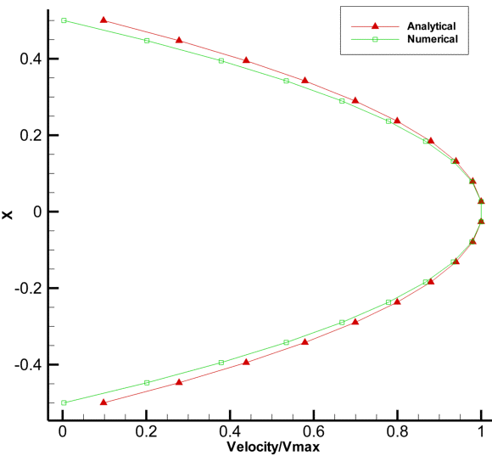
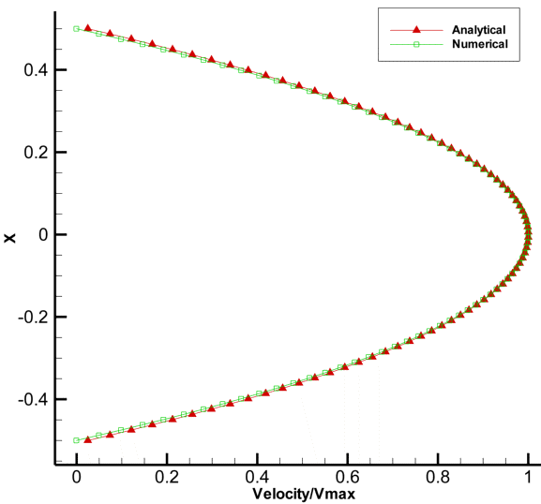
GCH8108 course Morteza namvar winter 2020
Verification of the Poiseuille flow
Verification of 20*20 grid
Verification of 80*80 grid

Slide 4
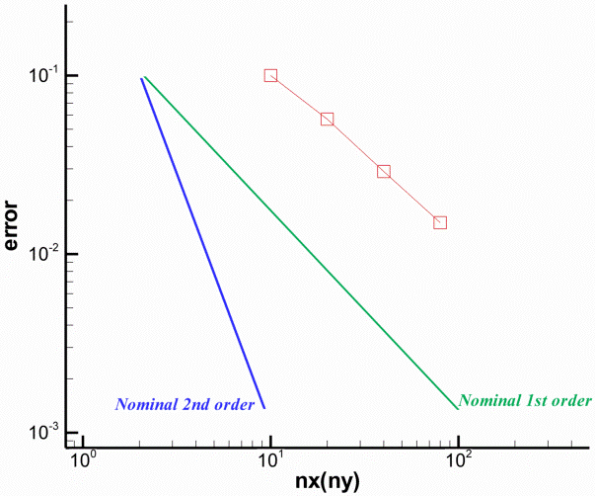
GCH8108 course Morteza namvar winter 2020
Order of scheme

